Slide 1
Ben Franklin As President Of Pennsylvania
By: Kiona Moses

Slide 2
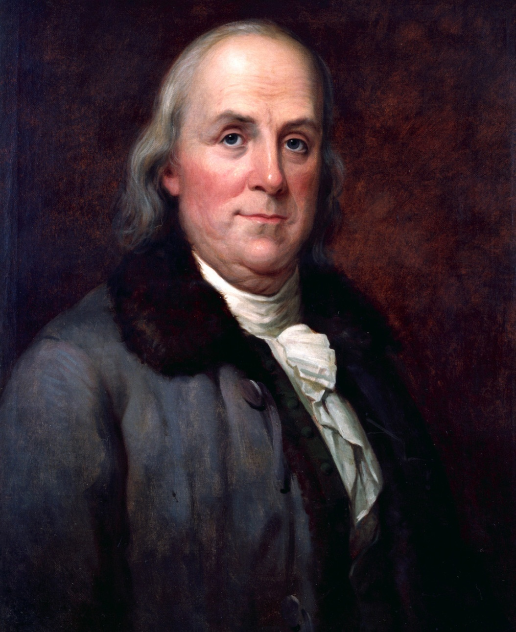
Franklin’s official portrait as Governor

Slide 3
The Beginning
In 1785 Benjamin Franklin was elected president of Pennsylvania. He was president from October 18, 1785 –December 1, 1788. He was the 6th president of Pennsylvania.
During his presidency Franklin was an ex-officio trustee.

Slide 4
Who he replaced.
Ben Franklin replaced John Dickinson less than 2 weeks before the regular election. It is not clear why Dickinson needed to be replaced.

Slide 5
Terms
Shortly after his initial election he was reelected to a full term on October 29, 1785, and again in the fall of 1786 and on October 31, 1787. His term concluded December 1, 1788. Franklin held that office for slightly over three years, longer than any other, and served the Constitutional limit of three full terms.

Slide 6
Near the End
But there is some question regarding the end of his term, suggesting that the aging Franklin may not have been actively involved in the day-to-day operation of the Council toward the end of his time in office.

Slide 7
Bibliography
http://en.wikipedia.org/wiki/Benjamin_Franklin
http://www.archives.upenn.edu/people/1700s/franklin_ben.html
http://explorepahistory.com/displaygallery.php?gallery_id=76&bcolor=tan&list=1

