Slide 1
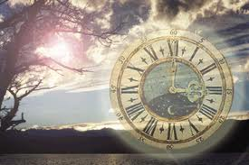
Daylight Saving Time
“Spring forward, Fall back”

Slide 2
The History of Daylight Savings Time:
Daylight Savings Time was created to save energy and power in the Spring.
Daylight Savings allows humans to enjoy a longer daytime during the Spring and Summer months, and to sleep longer at night in the fall and winter months.

Slide 3
The Pro’s of Daylight Savings Time:
The pros are that when used, Daylight Savings help save energy and sleep time.
It also helps save money because as people stay out of their house longer because they can enjoy longer daylight hours, less energy is being consumed and therefore utility bills are lower.

Slide 4
The Con’s of Daylight Savings Time:
The cons for the people who don’t use it, they waste money, time and energy.
Also, it wastes sleep time and body energy.

Slide 5
DID YOU KNOW…
MR. FRANKILN WAS IN PARIS AND OBSERVED THE CHANGES IN THE SUN DURING BOTH THE SPRING AND FALL SEASONS.
IN THE SPRING, THE SUN SHINES AN HOUR LONGER EACH DAY THAN DURING OTHER SEASONS OF THE YEAR.
AND IN THE FALL, THE SUN SETS AN HOUR EARLIER THAN DURING OTHER SEASONS OF THE YEAR.

Slide 6
Bibliography:
Buzzle.com
Answers.com

