Slide 1
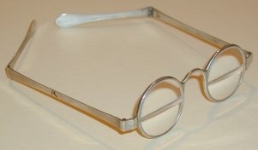
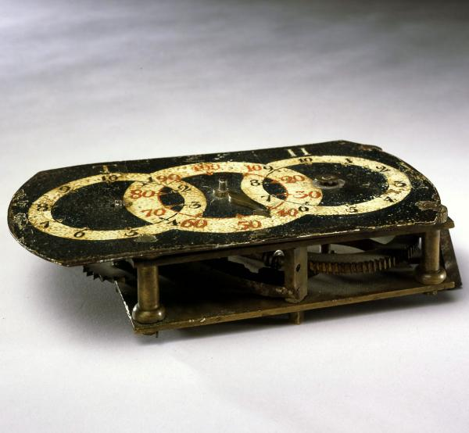
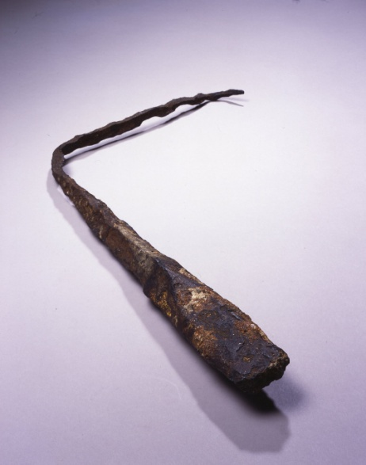
The Rockys
OUR SPECIAL SALES!
Bifocals 50% off
Now $100.99
Odometer $100 off
Lightning Rode 70% off

Slide 2
Every one knows about the good thing about Bifocals. Bifocals have 2 different glasses in 1 But sadly they are expensive and most people cant afford it. But for a limited time only we are offering the Bifocals 50% off. THAT’S RIGHT 50% OFF!!! Now you can get bifocals for $100 (Retail price $150.00) But wait if you buy one you will get another pair with an extra charge of $10 You will save $189 But Hurry this is for a limited time only! Buy yours today at your local Rockys store.
Bifocals 50% off
Now $100 buy extra pair for $10
And save $189

Slide 3
Are you worried that every time a storm comes your home will be struck by lighting that all you can do is nothing but hope that it doesn’t come? Well now you don’t have to worry Introducing the “Lighting rode”! The lightning rode is a amazing scientific invention. When a lighting is about to strike the rode on the roof attracts the lightning the rode connected to copper wire leading underground so then the electric goes safely under ground and doesn’t stick your house. You may be wondering how much this revolutionary invention costs and we got a revolutionary price. Due to increasing light strikes and lightning rode demands we offer it for $315 70% off! (Retail price $450) This offer will only last for 2 weeks so hurry and get one today
Lightning rode $315 70% off save $135

Slide 4
Are you wondering how fast your horse should travel to get to your destination in time. We present to you the odometer. A simple instrument that tells you how fast you are whether you are in a horse or simply running.

