Slide 1
Philosophical Society
By Elli Perez

Slide 2
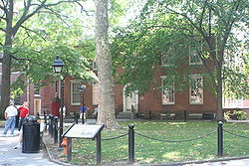
What is the American Philosophical Society?
The American Philosophical society is a discussion group founded in 1743 by Benjamin Franklin.
The society studies a wide variety of disciplines in humanity and in science.
It is located east of Independence Hall and is part of the Independence National Historical Park.
The APS was also designated a National Historic Landmark in 1966.

Slide 3
Who joined the society?
Some of the earliest members of the Society included George Washington, John Adams, Thomas Jefferson, Thomas Paine, Nicholas Biddle, Benjamin Rush, and many others.
The society also attracted other philosophers as members, such as Alexander von Humboldt, the Marquis de Lafayette, Baron von Steuben, and others.

Slide 4
What happened to the society?
By 1746, the society had grown inactive.
In 1767, it was ‘revived’.
On January 2, 1769, the society united with the American Society for Promoting Useful Knowledge.
Benjamin Franklin was elected as the first president of the group.
After the American Revolution, Leadership was handed over to Francis Hopkinson
The society received land under his influence.

Slide 5
Bibliography
http://en.wikipedia.org/wiki/American_Philosophical_Society

